Slide 1

Final Project Presentation
Telco Customer Churn
Indah Rahmawati Kuniyo
JC Data Science Batch 2

Slide 2
Outlines
01
Objectives
02
Data Analysis
03
Data Preprocessing
04
Prediction and Evaluate

Slide 3
Objectives –
What’s Customer Churn?
To predict customer churn by assessing their propensity of risk to churn
Focusing customer retention marketing programs base who are most vulnerable to churn

Slide 4

Data Analysis

Slide 5
Method
Fill Missing Values, check data feature, check distribusi data
Check Outlier, one hot encoding, label encoder,feature engineering
Comparing all feature with target
K Fold, pipeline

Slide 6
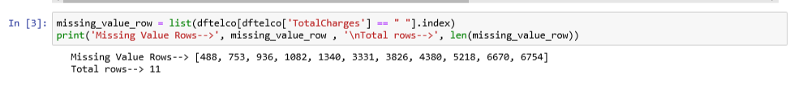
Missing Values

Slide 7
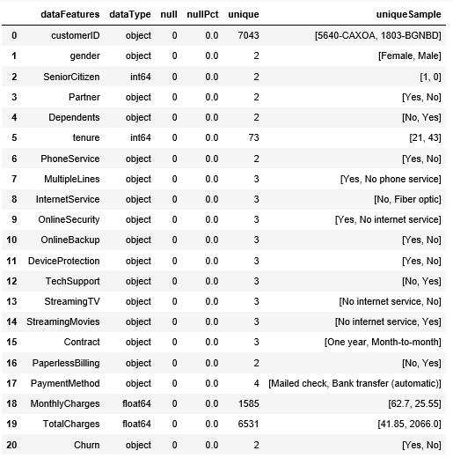
Data Feature

Slide 8
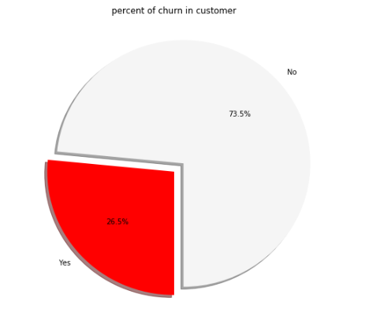
Customer Churn

Slide 9
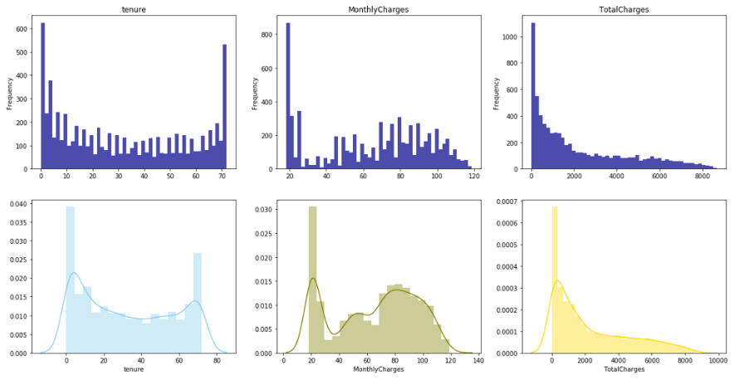
Distribusi Data

Slide 10
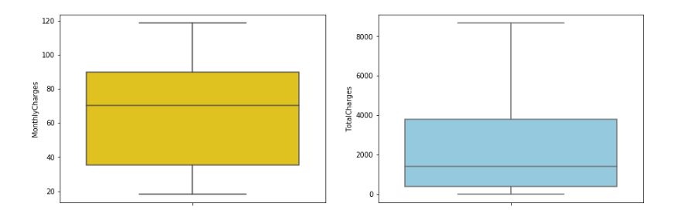
Check Outlier

Slide 11
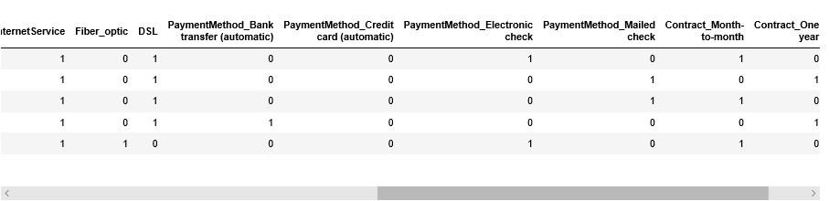
Create New Binary Columns

Slide 12
Lets plot variables to our target

Slide 13
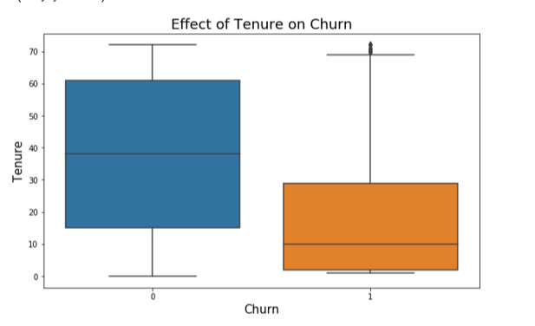
Tenure vs Churn

Slide 14
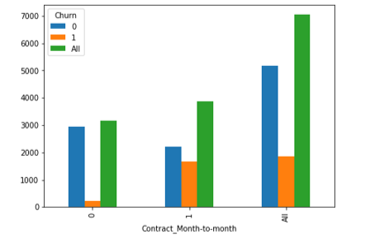

Contract vs Churn

Slide 15
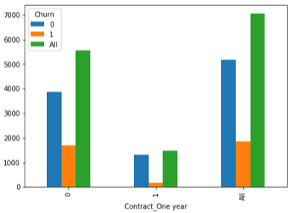

Contract vs Churn

Slide 16
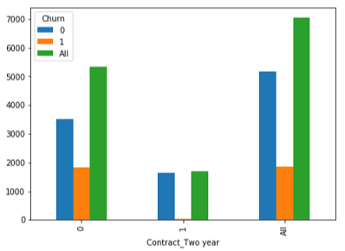

Contract vs Churn

Slide 17
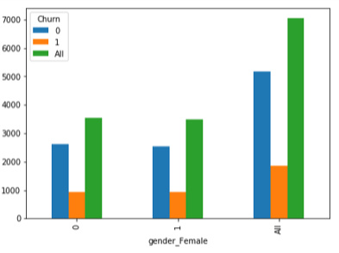
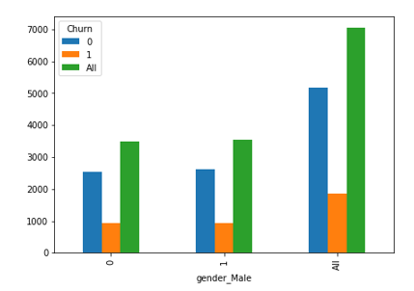
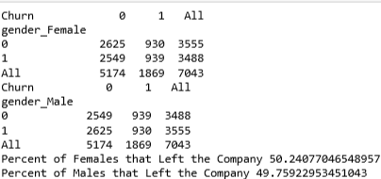
Gender vs Churn

Slide 18
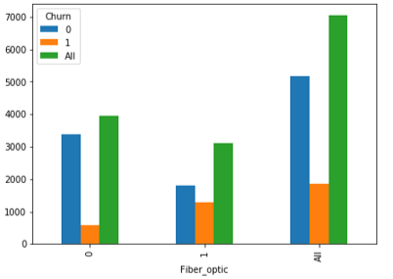
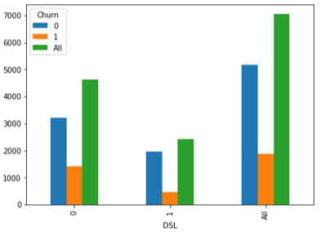
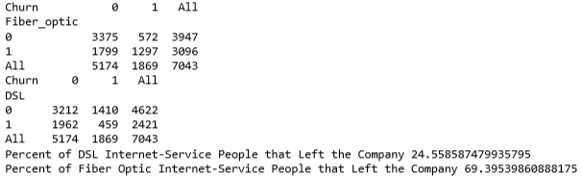
InternetServices vs Churn

Slide 19
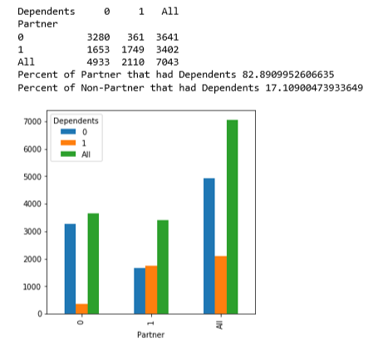
Partner vs Dependents

Slide 20
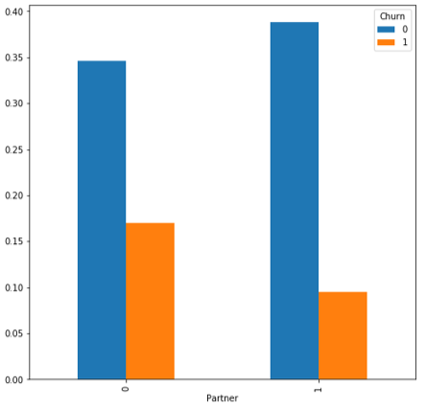
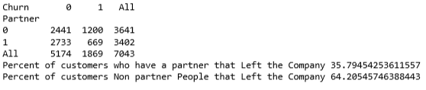
Partner vs Churn

Slide 21
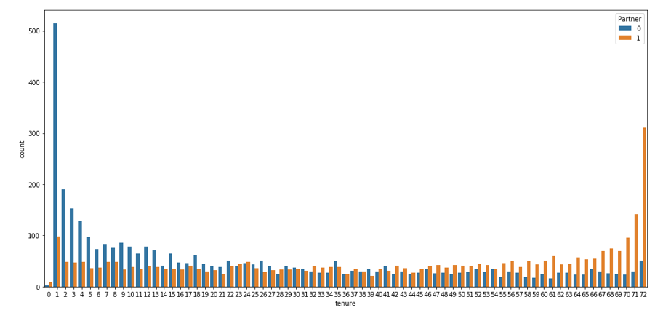
Partner vs Tenure

Slide 22
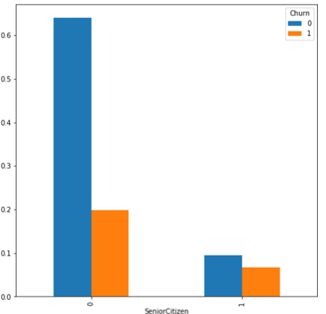
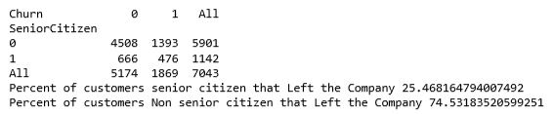
SeniorCitizen vs Churn

Slide 23
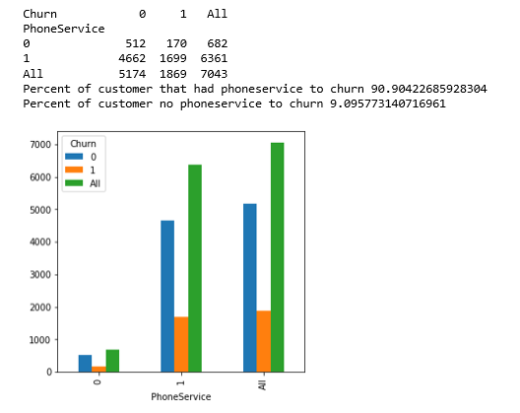
PhoneService vs Churn

Slide 24
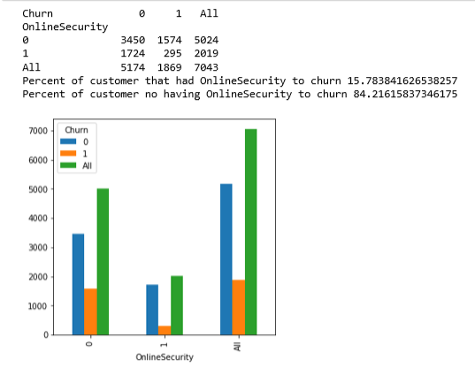
OnlineSecurity vs Churn

Slide 25
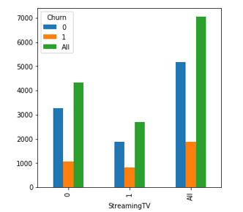
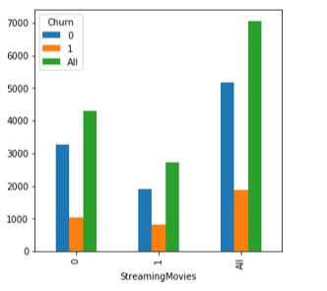
StreamingTV,
StreamingMovies vs Churn

Slide 26
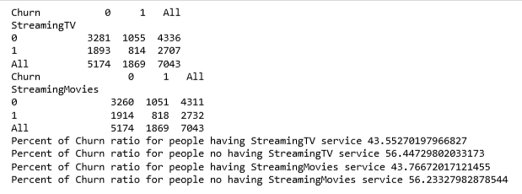
StreamingTV,
StreamingMovies vs Churn

Slide 27
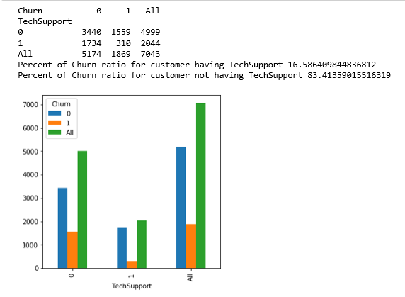
TechSupport vs Churn

Slide 28
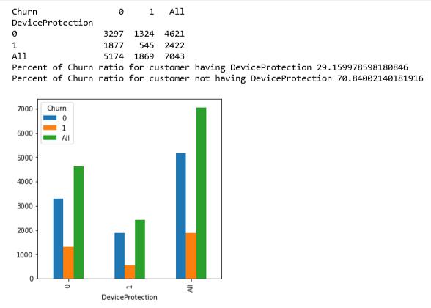
DeviceProtectionvs Churn

Slide 29
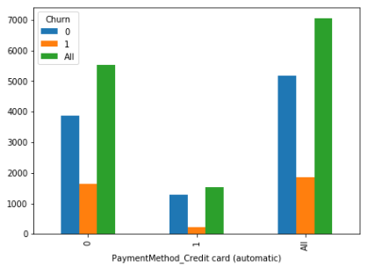
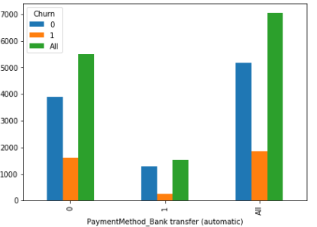
PaymentMethod
vs Churn

Slide 30
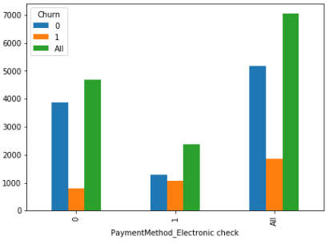
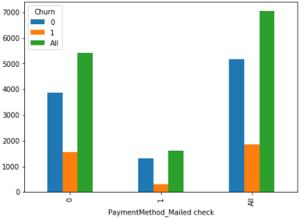
PaymentMethod
vs Churn

Slide 31
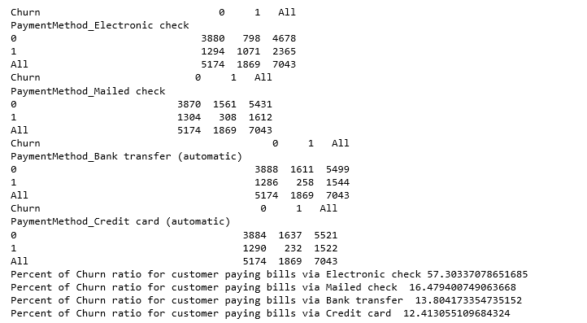
PaymentMethod
vs Churn

Slide 32
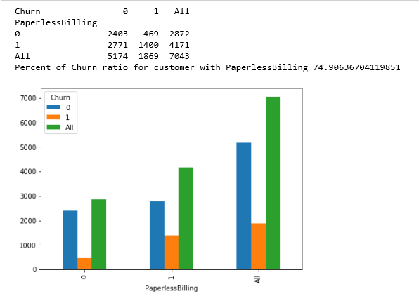
PaperlessBilling
vs Churn

Slide 33
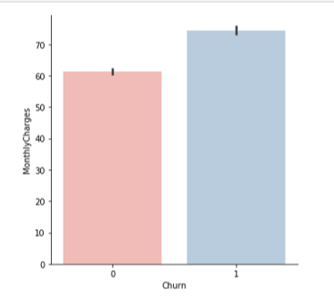
MonthlyCharges vs Churn

Slide 34
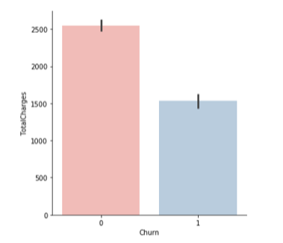
TotalCharges vs Churn

Slide 35
DATA PREPROCESSING
Split data into training data and testing data
GridSearch, K Fold
Pipeline

Slide 36
Prediction and Evaluation

Slide 37
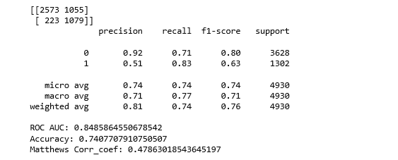
XGBClassifier model with balance dataset evaluation
Train Evaluation

Slide 38
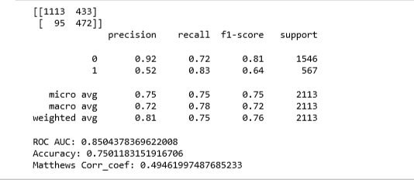
XGBClassifier model with balance dataset evaluation
Test Evaluation

Slide 39
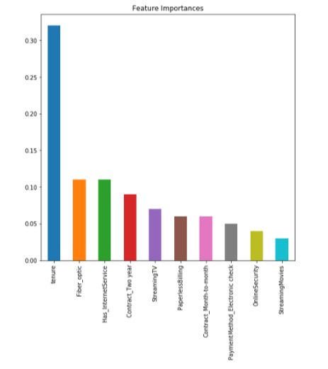
Feature Importances

Slide 40
Thank You

